Slide 1
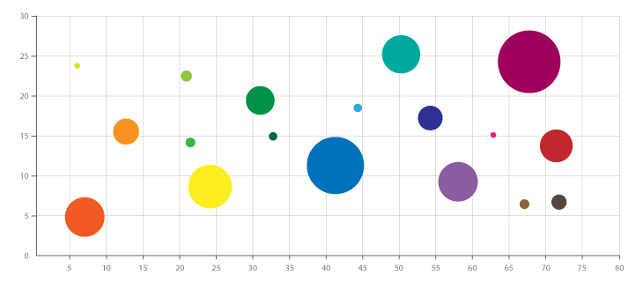
What is a Bubble Chart?
Ideal for understanding the relationship between three dimension
Similar to scatter plot
Uses the 2 coordinate system and the area of circle to represent the third dimension
Scatter Plot
Bubble Chart

Slide 2
Where it can be used?
Bubble charts can facilitate the understanding of relationships
Which of our agencies delivers the most net new leads and social buzz per dollar we pay them in fees?
As we increase social spend, what happens to downloads and revenue?

Slide 3
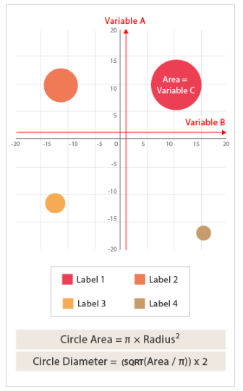
How to read a Bubble Chart ?

Slide 4
Advantages & Dis-Advantages
Are visually cheerful
Easy to view 3 dimensions in 2D coordinate system
Use easy-to-understand shapes, colors, sizes and patterns to enable insight
Give a good sense of correlations, both positive and negative
It can also be used as a quadrant chart
Dis-advantages :
Due to circle sizes, can be difficult to get actual values
Cannot be used to display a lot of data

